Slide 1


MAP Compliance Monitoring & Violation Alerting solution

Slide 2

The objective of the MAP monitoring project is to help the manufacturer continuously monitor reseller advertisements at the SKU level and identify pricing violations.
The solution will integrate manufacturer product data containing MAP and LPP values with reseller and advertised-price data

Slide 3
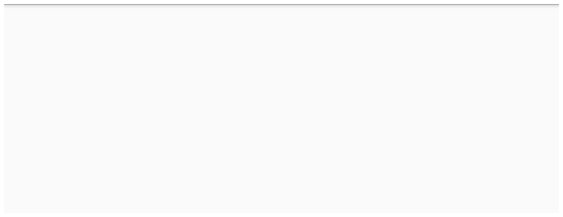
MAP Project – High-Level Architecture
Data Sources → Data Collection →
Data cleaning & Integration → MAP/LPP Analysis →
Violation Tracking → Email Action →
Excel Reporting → Power BI Dashboard

Slide 4










EXCEL \ DB
WEB \ API
Manufacturer Data
Reseller Data • Reseller ID
Reseller Ads/Listings
DATA SOURCES
• SKU • MAP • LPP
• SKU
• Name • Email
• Advertised Price
─────────────────┼──────────────────┘
• Date
↓
DATA LOADING
PYTHON
Extract / Load data
↓
• SKU validation
• Remove duplicates
DATA PRE-PROCESSING
• Handle missing values • Standardize prices
• Standardize reseller
↓
DATA INTEGRATION
Join different tables to create unique key
Reseller ID + SKU
↓
NO ↓
Is Advertised Price < MAP?
YES ↓
Compliant with Policy
Is Price < LPP?
NO
↓
YES ↓
↓
Collect details for Log
LPP Violation ↓
Check Violation History
MAP \ LPP DECISION LOGIC
for Reseller + SKU
↓
YES
First \ Second Violation?
↓
NO ↓
WARNING EMAIL
AGREEMENT
↓
VIOLATION ↓
AUTOMATION CANBE IMPLEMENTED ONLY AFTER APPROVAL
Send MAP policy warning E-mail for specific SKU
Send agreement violation
E-mail and ask to stop
selling specific SKU
┌──────────────────┴─────────────────┐
↓
↓
Excel Reports
Power BI Dashboard
DOCUMENT VIOLATION HISTORY
• Violations
• Resellers
• SKU analysis
• Trends
• Top offenders
• SKU analysis
EXCEL
POWER BI
↓
TESTING & REFINEMENT
↓
DEPLOYMENT & HANDOVER

